Slide 1
Refine Knowledge of Large Language Models
via Adaptive Contrastive Learning
A presentation based on the research paper:
https://arxiv.org/pdf/2502.07184
By Aishly Manglani

Slide 2
Why this Paper Matters
The paper proposes a solution called Adaptive Contrastive Learning (ACL)
01
02
03
04
LLMs are powerful, but they sometimes hallucinate
Hallucinations = confident answers that are actually wrong
These mistakes happen not just from missing facts
They come from the model misunderstanding what it knows

Slide 3
What the Paper tries to solve
LLMs currently struggle with:
Knowing what they truly know
Knowing what they only partially know
Correcting wrong knowledge
Recognizing when they simply do not know
This leads to misleading or unsafe answers.

Slide 4
Human Learning as Inspiration
Humans naturally separate knowledge into:
Confident knowledge
Partial knowledge
Incorrect knowledge
Unknowns
LLMs do not do this automatically. ACL aims to bring human-like learning into LLMs.

Slide 5
Why current methods fall short
The paper explains key problems:
Most systems only use “known” vs “unknown”
They ignore the important gray areas
Models rarely say “I don’t know”
Hallucinations often come from unknown unknowns
Contrastive learning helps humans compare right and wrong ideas but LLMs rarely use it to refine their knowledge

Slide 6
Strengths of LLMs (Despite Hallucinations)
LLMs are excellent at:
Understanding enormous amounts of text
Grasping context and subtle language cues
Learning new tasks with little data
Handling text, images, audio, and mixed formats

Slide 7

The paper groups model knowledge into four categories:
Correct and Confident (Known Knowns)
Correct but Uncertain (Unknown Knowns)
Incorrect Knowledge (Wrong Knowns)
Missing Knowledge (Known Unknowns)
These categories help determine how the model should learn.
Four Knowledge States

Slide 8
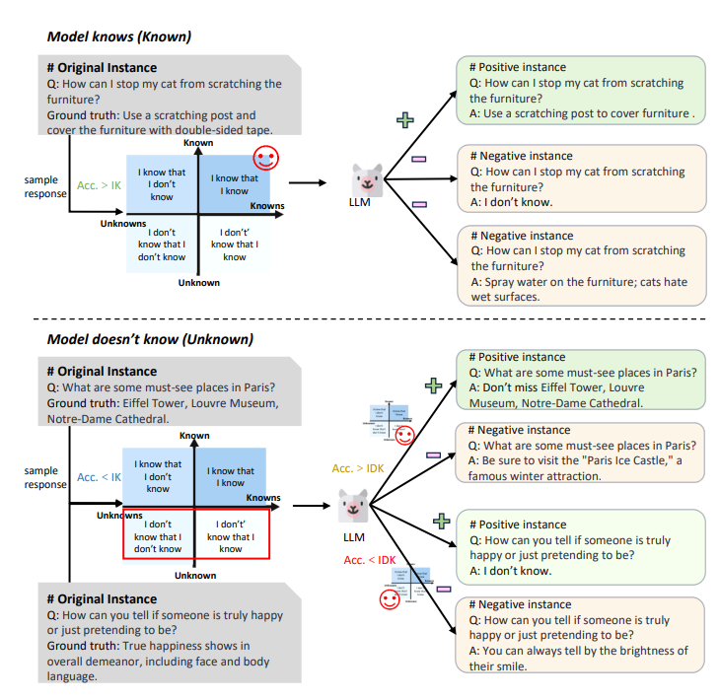
Adaptive Contrastive Learning(ACL)
ACL helps the model refine its knowledge through:
Strengthening
Deepening
Correcting
Admitting uncertainty
ACL uses different techniques depending on the knowledge type.

Slide 9
ACL Steps
01
02
03
Adaptive Sampling
Contrastive Learning
Measuring Knowledge Boundaries
Correct and confident → reinforce
Correct but uncertain → clearer positive examples
Incorrect knowledge → stronger negative samples
Missing knowledge → encourage honest “I don’t know” responses
Goal:
Bring correct knowledge representations closer
Push incorrect representations farther apart
We check:
How often it is correct
How often it claims it knows
How often it shows uncertainty

Slide 10
Result and Finding
ACL leads to:
Fewer hallucinations
More accurate “I don’t know” responses
Better factual accuracy
More reliable and transparent answers
Before ACL → the model invented facts. After ACL → the model corrected itself or admitted uncertainty.

Slide 11
Dataset and Evaluation
Metrics included:
Accuracy
Truthfulness
Honesty
Calibration
Hallucination rate
ACL performed better across all metrics.

Slide 12
The authors conclude:
Hallucinations can be reduced by improving how models understand their own knowledge
Adaptive Contrastive Learning offers a human-inspired solution
ACL teaches models to:
reinforce correct knowledge
correct mistakes
deepen partial understanding
recognize uncertainty
This makes LLMs safer, more accurate, and more trustworthy
Conclusion

Slide 13
Thank you

